Slide 1


House Prices: Advanced Regression Techniques
Kaggle Competition Analysis
Zaeem Sabir
ROll No # 2024-MS-DS-136

Slide 2
Competition Overview
Objective
Dataset
Predict house sale prices using advanced regression techniques.
79 features describing various aspects of residential homes in Ames, Iowa.

Slide 3

Problem Statement
Predict the final sale price of homes based on provided features.

Slide 4
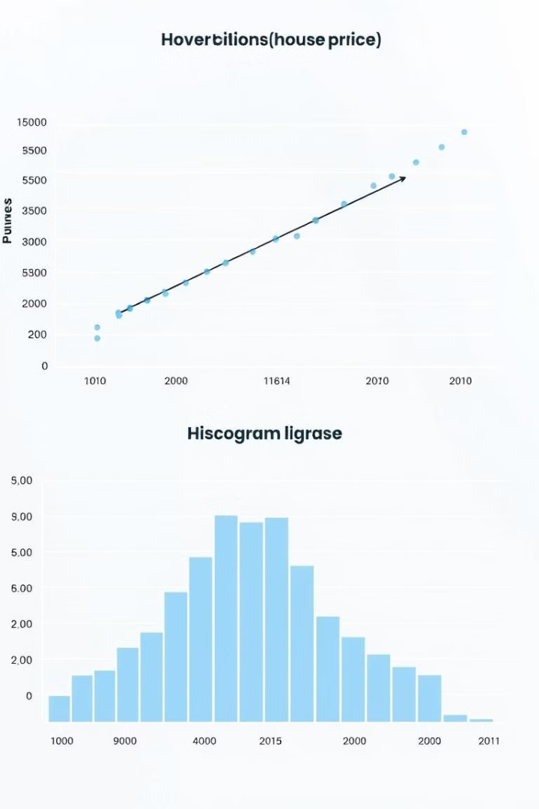
Data Exploration
1
Initial Analysis
2
Missing Values
Understand data characteristics, identify potential trends, and spot outliers.
Address missing data points using imputation or feature removal.

Slide 5
Feature Engineering
Feature Selection
Feature Transformation
Select features most relevant to predicting house prices.
Encode categorical variables, scale numerical features, and engineer new features.

Slide 6
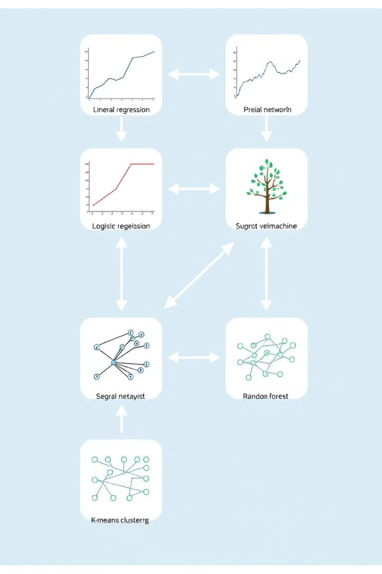
Modeling
Model Selection
Model Training
Explore linear regression, random forests, gradient boosting, and other regression models.
Train models on the dataset, using techniques like train-test split and cross-validation.

Slide 7


Model Evaluation
Performance Metrics
Results
Evaluate model performance using MSE, RMSE, and other relevant metrics.
Compare the performance of different models and identify the best-performing one.

Slide 8


Conclusion
Findings
1
Summarize key insights from data exploration and model evaluation.
Future Work
2
Suggest potential improvements or next steps, such as exploring additional features or advanced techniques.

